Slide 1
An Introduction to the Kalman Filter
Sajad Saeedi G.
University of new Brunswick
SUMMER 2010

Slide 2
CONTENTS
1. Introduction
2. Probability and Random Variables
3. The Kalman Filter
4. Extended Kalman Filter (EKF)

Slide 3
Introduction
Controllers are Filters
Signals in theory and practice
1960, R.E. Kalman for Apollo project
Optimal and recursive
Motivation: human walking
Application:
  aerospace, robotics, defense scinece,
  telecommunication,
  power pants,
  economy, weather, …

Slide 4
CONTENTS
1. Introduction
2. Probability and Random Variables
3. The Kalman Filter
4. Extended Kalman Filter (EKF)

Slide 5
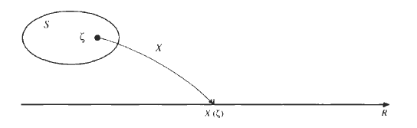
Probability and Random Variables
Probability
  Sample space
  p(A∪B)= p(A)+ p(B)
  p(A∩B)= p(A)p(B) Joint probability(independent)
  p(A|B) = p(A∩B)/p(B) Bay’s theorem
Random Variables (RV)
  RV is a function, (X)
  mapping all points in the sample space to real numbers

Slide 6
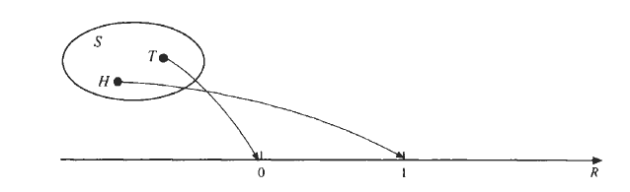



Probability and Random Variables
Cont.

Slide 7
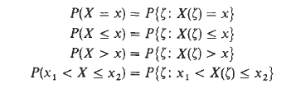
Probability and Random Variables
Cont.
Example: tossing a fair coin 3 times (P(h) = P(t))
Sample space = {HHH, HHT, HTH, THH, HTT, TTH, THT, TTT}
X is a RV that gives number of tails
P(X=2) = ? {HHH, HHT, HTH, THH, HTT, TTH, THT, TTT}
P(X<2) = ? {HHH, HHT, HTH, THH, HTT, TTH, THT, TTT}

Slide 8


Probability and Random Variables
Cumulative Distribution Function (CDF), Distribution Function
Properties

Slide 9
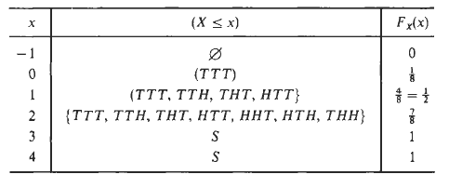
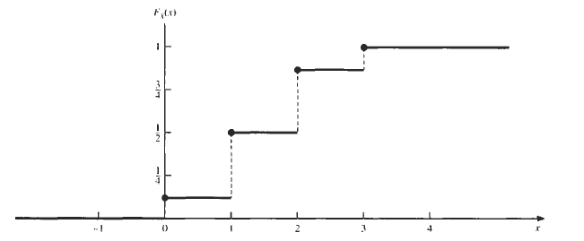
Probability and Random Variables
Cont.

Slide 10
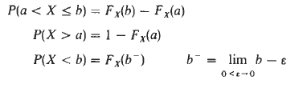
Probability and Random Variables
Determination of probability from CDF
Discrete, F_{X} (x) changes only in jumps, (coin example) , R=ponit
Continuous, (rain example) , R=interval
Discrete: PMF (Probability Mass Function)
Continuous: PDF (Probability Density Function)

Slide 11
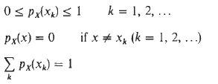

Probability and Random Variables
Probability Mass Function (PMF)

Slide 12

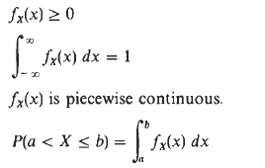

Probability and Random Variables

Slide 13
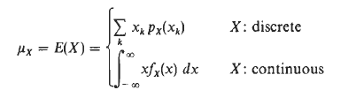


Probability and Random Variables
Mean and Variance
Probability weight averaging

Slide 14

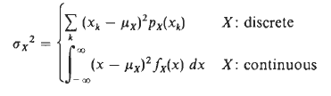
Probability and Random Variables
Variance

Slide 15
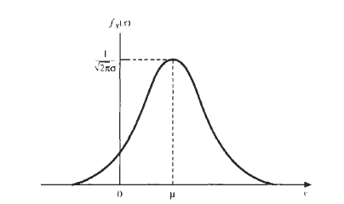
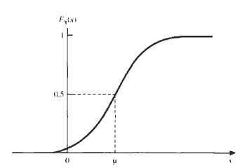



Probability and Random Variables
Normal Distribution (Gaussian)
Standard normal distribution

Slide 16
Probability and Random Variables
Example of a Gaussian normal noise

Slide 17
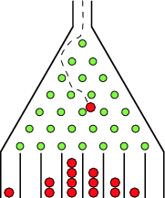
Probability and Random Variables
Galton board
Bacteria lifetime

Slide 18
Probability and Random Variables
Random Vector
Covariance Matrix
Let x = {X₁, X₂, ..., X_{p}} be a random vector with
mean vector µ = {µ₁, µ₂, ..., µ_{p}}.
Variance: The dispersion of each X_{i} around its mean is measured by its variance (which is its own covariance).
Covariance: Cov(X_{i}, X_{j} ) of the pair {X_{i}, X_{j} }is a measure of the linear coupling between these two variables.

Slide 19
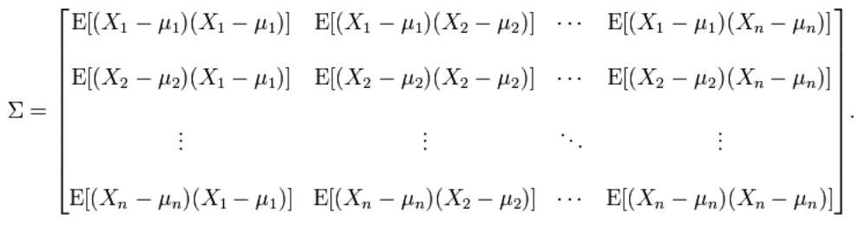
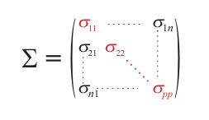
Probability and Random Variables
Cont.

Slide 20
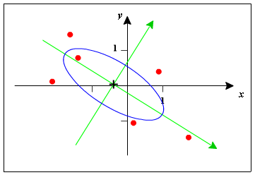
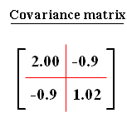
Probability and Random Variables
example

Slide 21
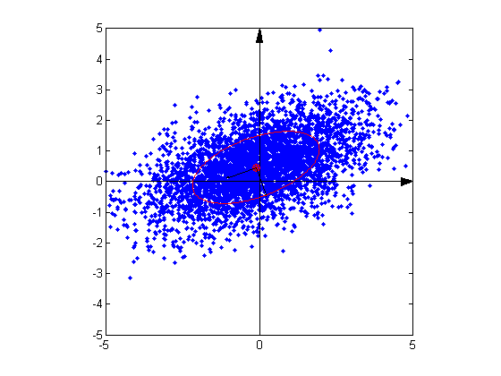
Probability and Random Variables
Cont.

Slide 22




Probability and Random Variables
Random Process
  A random process is a mathematical model of an empirical process whose model is governed by probability laws
  State space model, queue model, …
Fixed t, Random variable
Fixed sample, Sample function (realization)
Process and chain

Slide 23


Probability and Random Variables
Markov process
State space model is a Markov process
Autocorrelation:
    a measure of dependence among RVs of X(t)
If the process is stationary (the density is invariant with time), R will depend on time difference

Slide 24
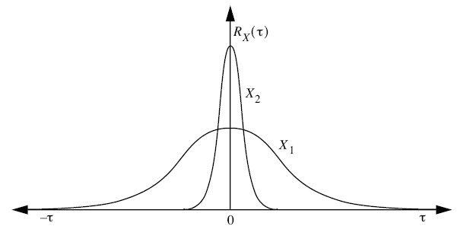
Probability and Random Variables
Cont.

Slide 25
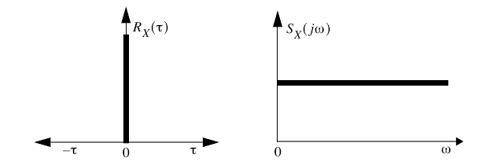

Probability and Random Variables
White noise: having power at all frequencies in the spectrum, and being completely uncorrelated with itself at any time except the present (dirac delta autocorolation)
At any sample of the signal at one time it is completely independent(uncorrelated) from a sample at any other time.

Slide 26
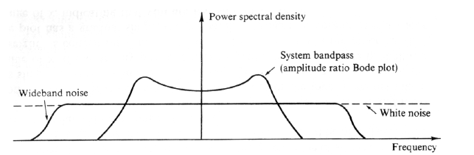
Stochastic Estimation
Why white noise?
    No time correlation → easy computaion
    Does it exist?

Slide 27

Stochastic Estimation
Observer design
    Blackbox problem
    Observability
    Luenburger observer

Slide 28
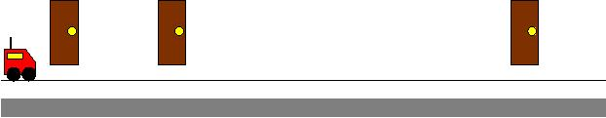
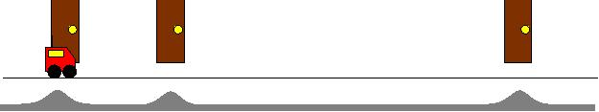
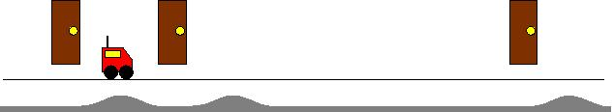
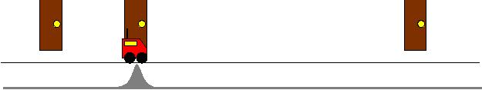
Stochastic Estimation
Belief
Initial state
detects nothing:
Moves and
detects landmark:
Moves and
detects nothing:
Moves and
detects landmark:

Slide 29
Stochastic Estimation
Parametric Filters
  Kalman Filter
  Extended Kalman Filter
  Unscented Kalman Filter
  Information Filter
Non Parametric Filters
  Histogram Filter
  Particle Filter

Slide 30
CONTENTS
1. Introduction
2. Probability and Random Variables
3. The Kalman Filter
4. Extended Kalman Filter (EKF)

Slide 31
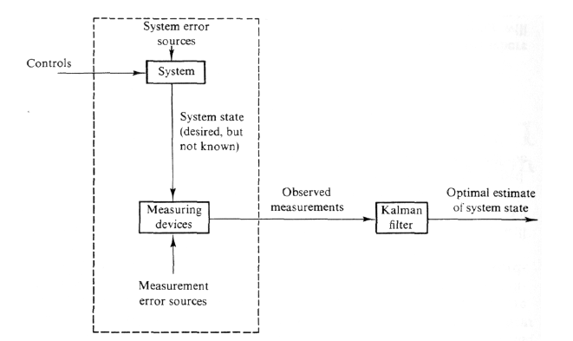
The Kalman Filter
Example1: driving an old car (50’s)

Slide 32
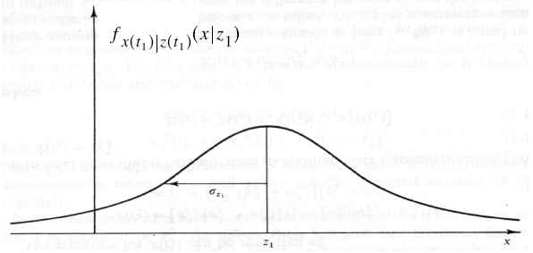


The Kalman Filter
Example2: Lost at sea during night with your friend
Time = t₁

Slide 33
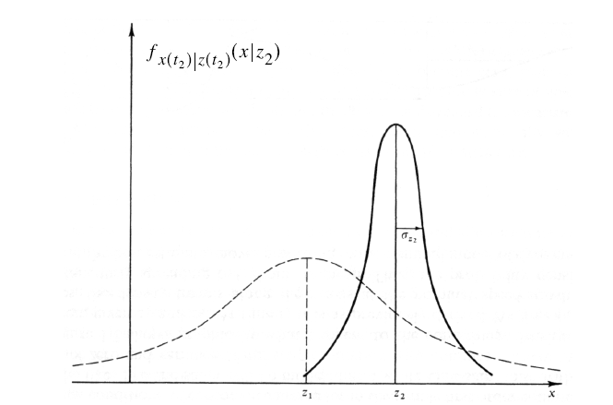
The Kalman Filter
Time = t₂

Slide 34
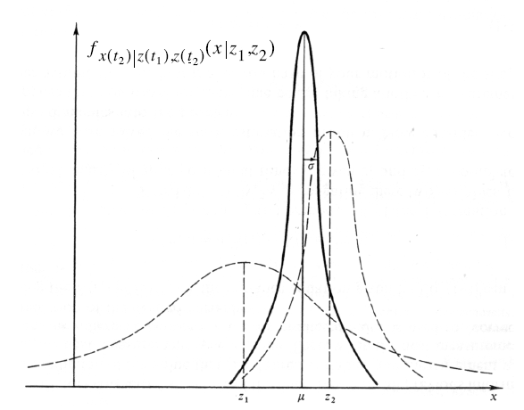



The Kalman Filter
Time = t₂

Slide 35




The Kalman Filter
Time = t₂

Slide 36

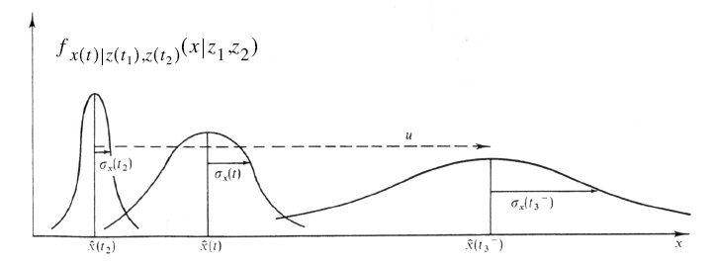
The Kalman Filter
Time = t₂ is over
Process model
w is Gaussian with zero mean and

Slide 37




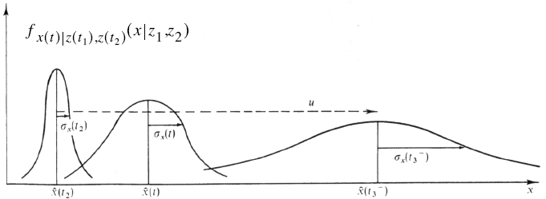
The Kalman Filter
.

Slide 38








The Kalman Filter
More detail

Slide 39



The Kalman Filter
More detail

Slide 40
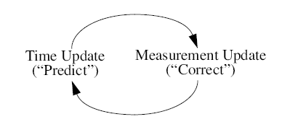
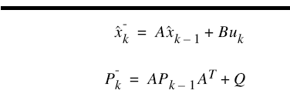
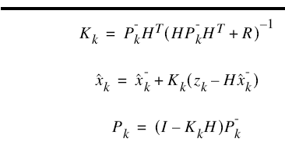
The Kalman Filter
brief.

Slide 41
The Kalman Filter
MATLAB example, voltage estimation
Effect of covariance

Slide 42
Tunning
Q and R parameters
Online estimation of R using AI (GA, NN, …)
Offline system identification
Constant and time varying R and Q
Smoothing

Slide 43
CONTENTS
1. Introduction
2. Probability and Random Variables
3. The Kalman Filter
4. Extended Kalman Filter (EKF)
5. Particle Filter
6. SLAM

Slide 44




EKF
Linear transformation
Nonlinear transformation

Slide 45


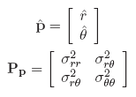




EKF
example

Slide 46



EKF
EKF
Suboptimal,
Inefficiency→ because of linearization
Fundamental flaw → changing normal distribution→ ad hoc

Slide 47
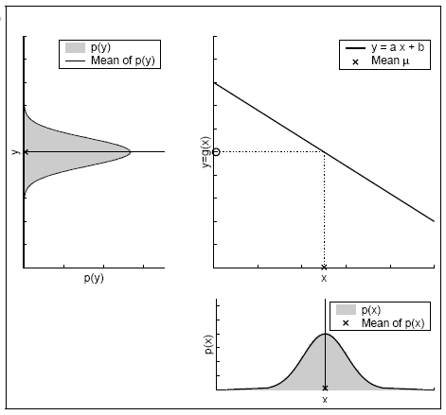
EKF

Slide 48
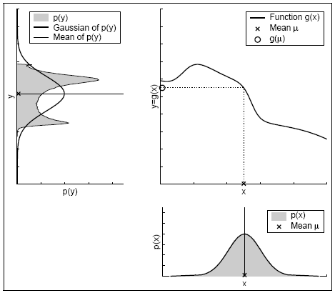
EKF

Slide 49
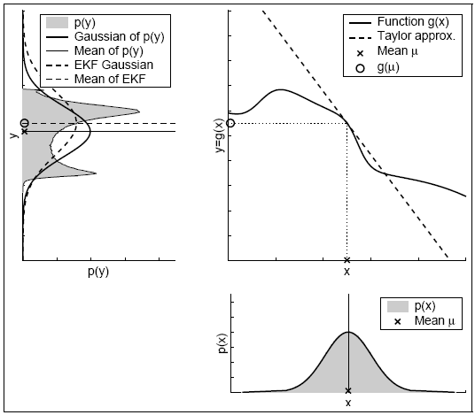
EKF

Slide 50
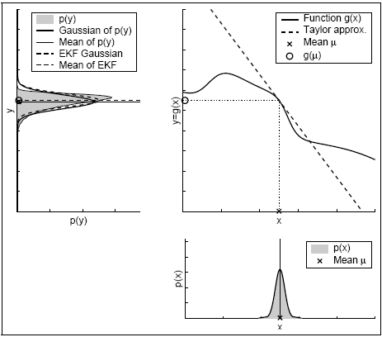
EKF

Slide 51
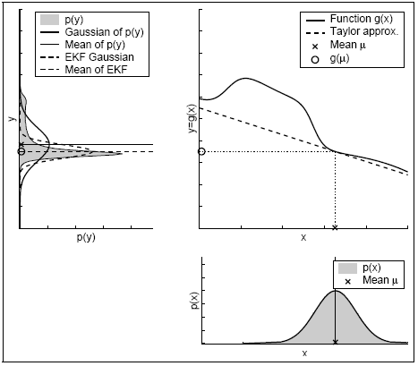
EKF

Slide 52
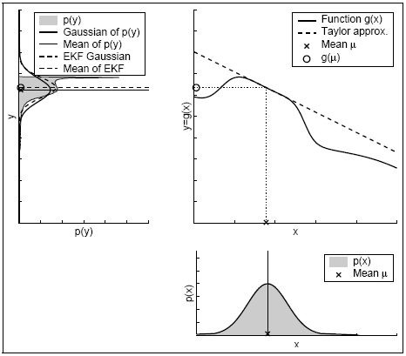
EKF

Slide 53
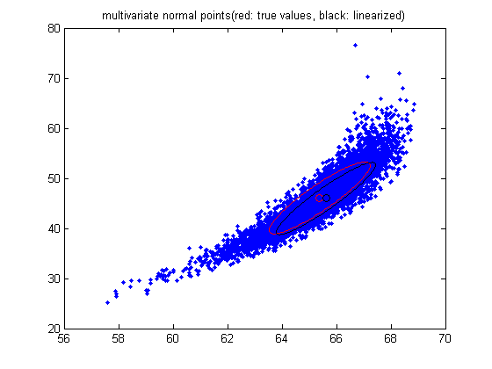
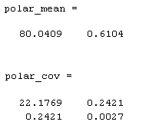
EKF
Cont.

Slide 54
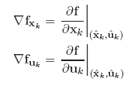



EKF
EKF

Slide 55


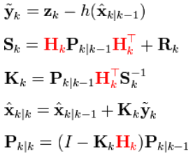


EKF
Model:
Step1: predict
Step2: correct
Notes:
In the extended Kalman filter, the state transition and observation models need not be linear functions of the state but may instead be differentiable functions.
This process essentially linearizes the non-linear function around the current estimate.
Unlike its linear counterpart, the extended Kalman filter in general is not an optimal estimator (of course it is optimal if the measurement and the state transition model are both linear, as in that case the extended Kalman filter is identical to the regular one). In addition, if the initial estimate of the state is wrong, or if the process is modeled incorrectly, the filter may quickly diverge, owing to its linearization.

Slide 56
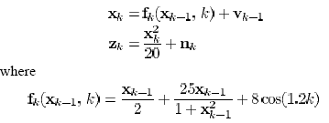


EKF
Example:

Slide 57
EKF
Assignment:
Consider following state space model:
x1(k) = sin((k-1)*x2(k-1)) +v
x2(k) = x2(k-1)
y = x1(k) + w
v is noisy input signal, v~N(0, 0.5),
w is observation noise, w~N(0, 0.1)
Simulate the system with given parameters and filter the states.
- MATLAB figures of states and covariance matrix

Slide 58

EKF_this assignments is optional
Assignment(optional): Ackerman steering car
process model (nonlinear):
States are (x, y, orientation)
observation model (linear):
H = [1 0 0;0 1 0; 0 0 1];
In x-y plane,
start from (0,0), go to (4,0), then (4,4), then (0,0)

Slide 59
EKF_this assignments is optional
  3 MATLAB figures, each including filtered and un-filterd x, y and orientation
  Simulation time, for T = 0.025
  V= 3; % m/s, forward velocity is fixed
  wheel base= 4;
  sigmaV= 0.3; % m/s
  sigmaG= (3.0*pi/180); % radians
  Q= [sigmaV^2 0; 0 sigmaG^2];
  sigmaX= 0.1; % m, x
  sigmaY= 0.1; % m, y
  sigmaO= 0.005; % radian,orientation

Slide 60
CONTENTS
1. Introduction
2. Probability and Random Variables
3. The Kalman Filter
4. Extended Kalman Filter (EKF)
5. Particle Filter
6. SLAM

Slide 61


Bayesian Estimation
Recursive Bayesian Estimation
  Known pdf for q and r
Given
Find
Notes:
SLAM is a process by which a mobile
robot can build a map of an environment
and at the same time use this map
to deduce its location. In SLAM, both
the trajectory of the platform and the
location of all landmarks are estimated
online without the need for any a priori
knowledge of location.

Slide 62


Bayesian Estimation
1) Chapman-Kolmogorov eq. (using process model)
2) update (using observation model)
Notes:
SLAM is a process by which a mobile
robot can build a map of an environment
and at the same time use this map
to deduce its location. In SLAM, both
the trajectory of the platform and the
location of all landmarks are estimated
online without the need for any a priori
knowledge of location.

Slide 63


Bayesian Estimation

Slide 64
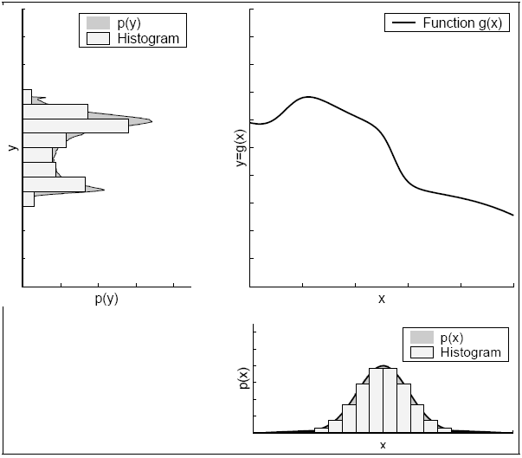
Histogram Filter

Slide 65
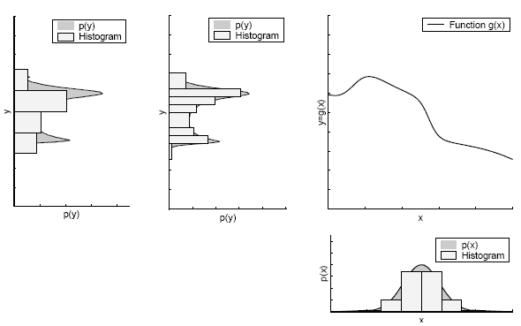
Histogram Filter

Slide 66
Particle Filter
Suboptimal filters
Sequential Monte Carlo (SMC)
  Based on the point mass (particle) representation of probability density
  Basic idea proposed in 1950s,
  1) but that time there were no fast machine
  2) and degeneracy problem
    Solution: resampling
Notes:
SLAM is a process by which a mobile
robot can build a map of an environment
and at the same time use this map
to deduce its location. In SLAM, both
the trajectory of the platform and the
location of all landmarks are estimated
online without the need for any a priori
knowledge of location.

Slide 67
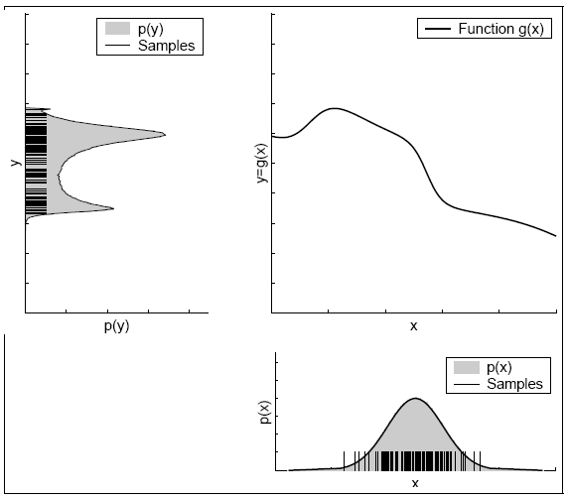
Particle Filter

Slide 68





Particle Filter
Monte Carlo Integration
Riemann sum
Approximation for Integral and expected value

Slide 69


Particle Filter
Importance Sampling (IS)
Importance or proposal density q(x)

Slide 70
Particle Filter
Sequential Importance Sampling (SIS)
  recursive
  The base for all particle (MC) filters:
  Bootstrap, condensation, particle, interacting particles, survival of fittest
Key idea:
  Represent required posterior density with a set of samples with associated weights
  Compute estimation based on samples

Slide 71
CONTENTS
1. Introduction
2. Probability and Random Variables
3. The Kalman Filter
4. Extended Kalman Filter (EKF)
5. Particle Filter
6. SLAM

Slide 72
SLAM
Simultaneous localization and mapping
  Build/update map + keep the track of the robot
  Complexity under noise and error
Different domain
  Indoor, outdoor, underwater, …
Solution→ Baysian rule, but there are problems
  Loop closing (consistent mapping)
  Convergence
  Computation power
Notes:
SLAM is a process by which a mobile
robot can build a map of an environment
and at the same time use this map
to deduce its location. In SLAM, both
the trajectory of the platform and the
location of all landmarks are estimated
online without the need for any a priori
knowledge of location.

Slide 73
SLAM
SLAM:
  Feature based
  View based
  Data Association
Solutions (Feature based):
  EKF-SLAM
  Graph-SLAM
  FAST-SLAM, (Particle Filter SLAM)

Slide 74
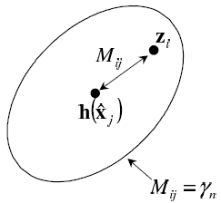


  Data Association
Data Association
  Mahalanobis distance (1936)

Slide 75

Data Association
Data Association (X² distribution)

Slide 76



Data Association
Data Association (X² distribution)

Slide 77

Feature based SLAM

Slide 78

SLAM
Probabilistic formulation

Slide 79


SLAM
Find
Given
  Process model
  Observation model

Slide 80

SLAM
Solution

Slide 81


EKF-SLAM
EKF-SLAM

Slide 82






EKF-SLAM

Slide 83
EKF-SLAM
Issues with EKF-SLAM
Convergence
  Map convergence
Computational Effort
  computation grows quadratically with the number of landmarks
Data Association
  The association problem is compounded in environments where landmarks are not simple points and indeed look different from different viewpoints.
Nonlinearity
  Convergence and consistency can only be guaranteed in the linear case

Slide 84

Graph-SLAM
Graph-SLAM

Slide 85
FAST-SLAM: Correlation
SLAM: robot path and map are both unknown!
Robot path error correlates errors in the map

Slide 86

FAST-SLAM
Rao-Blackwellized Filter (particle), FASTSLAM (2002)
  Based on recursive Mont Carlo sampling
  EKF-SLAM: Linear, Gaussian
  FAST-SLAM: Nonlinear, Non-Gaussian pose distribution
    Just linearzing observation model
  Monte Carlo Sampling

Slide 87

FAST-SLAM

Slide 88

FAST-SLAM
Key property:
  The pdf is on trajectory not on single pose
  Rao-Blackwellized state,
    the trajectory is represented by weighted samples
    Problem:
  Degenerecy

